Slide 1
Supplier training Presentation
How to navigate this presentation
If you have more than one monitor, please view the speaker notes by hitting F5 or choosing presentation mode.
If you are accessing via a laptop without an extra monitor, please choose the “View” tab and then choose “Notes Pages” in order to view the speaker notes.
RTX Corporation (Corporate) - Approved for Public Disclosure This document does not contain any export controlled technical material/data/information.

Slide 2
Supplier Training Module Conflict Minerals Compliance September 19, 2024
RTX Corporation (Corporate) - Approved for Public Disclosure This document does not contain any export controlled technical material/data/information.

Slide 3
Agenda
Introduction
Overview of Conflict Minerals and Dodd-Frank Act
Compliance timeline
RTX Business Units
RTX obligations
What we expect from you
Useful links
RTX Corporation (Corporate) - Approved for Public Disclosure This document does not contain any export controlled technical material/data/information.
Notes:
During this training we will provide an overview of Conflict Minerals and the Dodd-Frank Act. We will highlight which RTX Business Units are effected, explain our compliance timeline, and discuss RTX obligations. We will then describe what we expect from you and provide guidance on completing the supplier survey. We will also provide useful resources for your own conflict minerals compliance efforts.

Slide 4
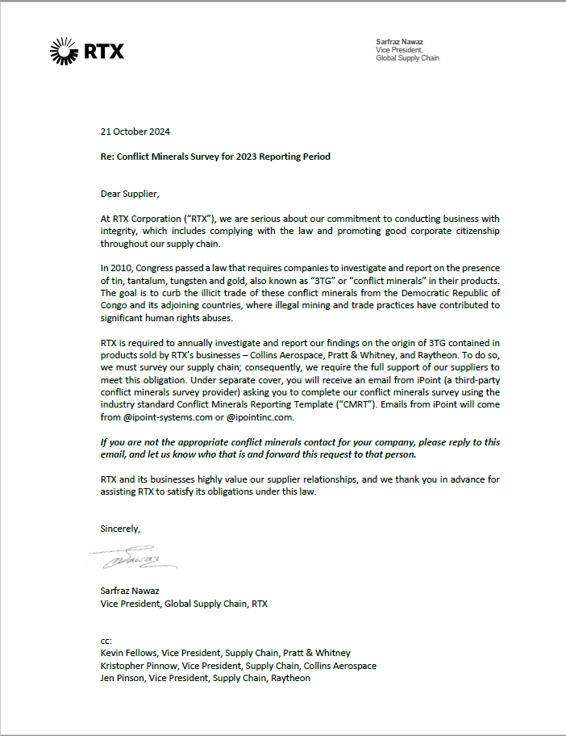
Introduction
Letter from RTX Senior Leadership:
RTX Corporation (Corporate) - Approved for Public Disclosure This document does not contain any export controlled technical material/data/information.
Notes:
At this time, please view the attached letter from RTX leadership on conflict minerals law and our expectations of our suppliers in helping us to comply with this law.
23 October 2023
Re: Conflict Minerals Survey for 2023 Reporting Period
Dear Supplier, At RTX Corporation (“RTX”), we are serious about our commitment to conducting business with integrity, which includes complying with the law and promoting good corporate citizenship throughout our supply chain. In 2010, Congress passed a law that requires companies to investigate and report on the presence of tin, tantalum, tungsten and gold, also known as “3TG” or “conflict minerals” in their products. The goal is to curb the illicit trade of these conflict minerals from the Democratic Republic of Congo and its adjoining countries, where illegal mining and trade practices have contributed to significant human rights abuses.
RTX is required to annually investigate and report our findings on the origin of 3TG contained in products sold by RTX’s business units – Collins Aerospace, Pratt & Whitney, and Raytheon. To do so, we must survey our supply chain; consequently, we require the full support of our suppliers to meet this obligation. Under separate cover, you will receive an email from iPoint (a third-party conflict minerals survey provider) asking you to complete our conflict minerals survey using the industry standard Conflict Minerals Reporting Template (“CMRT”). Emails from iPoint will come from @ipoint-systems.com or @ipointinc.com. If you are not the appropriate conflict minerals contact for your company, please reply to this email, and let us know who that is and forward this request to that person. RTX and its business units highly value our supplier relationships, and we thank you in advance for assisting RTX to satisfy its obligations under this law.
Sincerely, Sarfraz Nawaz Vice President, Global Supply Chain, RTX

Slide 5
Purpose
After this training you should be able to answer:
What are conflict minerals?
What is Dodd-Frank §1502?
Why is this law regarding conflict minerals important?
Who is affected by this law and who is not?
Why is RTX concerned with complying with the conflict minerals law?
What do you need to know?
What do we expect from you?
RTX Corporation (Corporate) - Approved for Public Disclosure This document does not contain any export controlled technical material/data/information.
Notes:
At the conclusion of this training you should be able to answer the following questions:
What are Conflict Minerals?
What is Dodd-Frank Section 1502?
Why is this new regulation to track Conflict Minerals important?
Who is affected by this regulation?
Why is RTX concerned with tracking Conflict Minerals?
What you need to know?
What we expect from you?

Slide 6
Dodd-Frank Act
An overview
Law and regulations require all U.S. publicly traded companies to determine if the parts/assemblies in their products contain tin, tungsten, tantalum, and/or gold (known as 3T&G or “Conflict Minerals”).
If any of these minerals are included in their product, the company must conduct a reasonable inquiry to determine if these minerals originate in the Democratic Republic of the Congo (DRC) or its nine adjoining countries.
RTX Corporation (Corporate) - Approved for Public Disclosure This document does not contain any export controlled technical material/data/information.
Notes:
On August 22, 2012, the U.S. Securities and Exchange Commission (SEC) adopted a final rule to implement reporting and disclosure related to “conflict minerals,” as directed by the Dodd-Frank Wall Street Reform and Consumer Protection Act of 2010. The rule requires manufacturers who are SEC filers to disclose whether the products they manufacture or contract to manufacture contain “conflict minerals” that are “necessary to the functionality or production” of those products.

Slide 7
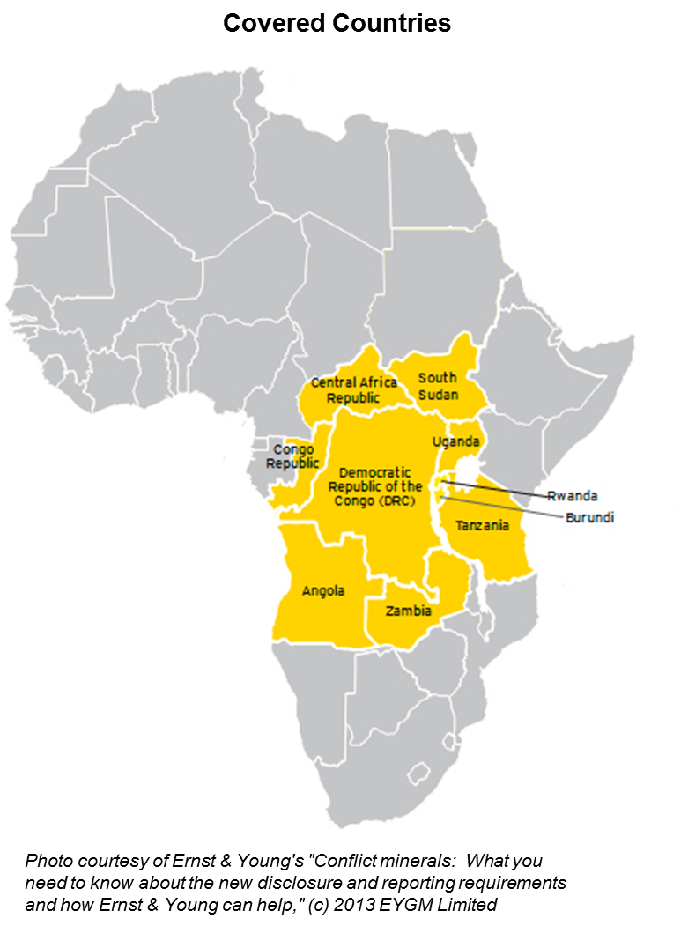
What are Conflict Minerals?
The SEC defined four minerals as “conflict minerals” (regardless of origin):
Tin Tantalum Tungsten Gold
The SEC defined “Covered Countries” as minerals sourced from the DRC or an adjoining country:
Angola
Burundi
Central African Republic
Republic of the Congo
Rwanda
South Sudan
Tanzania
Uganda
Zambia
RTX Corporation (Corporate) - Approved for Public Disclosure This document does not contain any export controlled technical material/data/information.
Notes:
Conflict minerals refer to tin, tantalum, tungsten and gold (commonly referred to as 3T&G), regardless of where they are sourced, processed or sold. The intent of these requirements is to further the goal of ending violent conflict in the Democratic Republic of the Congo (DRC) and in adjoining countries, which include Angola, Burundi, Central African Republic, Rwanda, South Sudan, Tanzania, Uganda and Zambia. These are collectively referred to as the Covered Countries. The conflict minerals originating from the Covered Countries may benefit armed groups perpetrating violence in the same countries
Congress chose to use U.S. securities laws focused on disclosures to staunch violence arising from the mining and trade of conflict minerals. The laws require companies to perform due diligence on suppliers to trace the source of conflict minerals in their supply chains, and to encourage companies to purchase their conflict minerals from sources that do not finance or benefit armed groups in the Covered Countries.

Slide 8
Compliance Timeline
Key Dates
The law went into effect Jan 1, 2013, and RTX has implemented its conflict minerals program
RTX must file its annual conflict minerals disclosure with the SEC on May 31
Obligations
RTX is obligated to comply with the conflict minerals rule and has processes and systems to support compliance with the conflict minerals rule
Supplier cooperation is essential to this ongoing compliance effort
RTX Corporation (Corporate) - Approved for Public Disclosure This document does not contain any export controlled technical material/data/information.
Notes:
The law went into effect at the beginning of 2013. Like many of our suppliers, RTX is legally obligated to comply with this rule. Compliance requires urgent attention on your part. We must file our annual conflict minerals report by May 31, and we will be relying on our supplier’s support to comply.

Slide 9
RTX Business Units
RTX Corporation (Corporate) - Approved for Public Disclosure This document does not contain any export controlled technical material/data/information.
Notes:
RTX and its business units are requiring suppliers to provide sourcing information annually. This includes identifying the smelters and refiners of 3T&G in their supply chain, to determine whether the materials found in their products ultimately originate in the DRC or an adjoining country.

Slide 10
RTX’s Obligations
Identify 3TG in products
RTX must determine whether its manufactured products contain conflict minerals
Understanding the rule and its impact on RTX
Supplier support is critical to the RCOI and due diligence phases
Conduct Reasonable Country of Origin Inquiry (RCOI) and due diligence
RTX BUs must determine whether their conflict minerals originate in the covered countries, by engaging with their suppliers through a RCOI. If after a RCOI, BUs have reason to believe conflict minerals originated in the covered countries, they must undertake due diligence.
Reporting
RTX must file a report with the SEC that discloses the measures they undertook during due diligence and the results of that inquiry.
RTX Corporation (Corporate) - Approved for Public Disclosure This document does not contain any export controlled technical material/data/information.
Notes:
Let’s take a look at the rule and what RTX is obliged to do under the law.
The law has 3 main steps:
The first is to investigate whether the products we manufacture contain tin, tantalum, tungsten or gold. If the products do contain these minerals, we are obliged to investigate our supply chain to determine where these minerals originated. The results of our investigation showed that some of our products do, indeed, contain one or more of these minerals, so we are moving onto the next step, called a Reasonable Country of Origin Inquiry.
Step two is an investigation of our supply chain. The first part of this investigation is called a Reasonable Country or Origin Inquiry, or an RCOI. Under an RCOI, we engage with our suppliers who provide components for the products we identified in step one. Through a survey, we ask whether the components you provided to us originated in the DRC or one of the covered countries. If not, and you can provide reasonable documentation about the country of origin, our investigations with you are complete. If the minerals used in your components did originate in one of the covered countries, or you are not sure of their origin, we must move into Due Diligence. Due Diligence is a much deeper examination of our supply chain, and we will ask you to contact your suppliers to determine the origin of the minerals used in the components you sold to us during the year.
Finally, step three is the mandatory filings that all SEC issuers must make to the SEC. Form SD documents the efforts we made in our RCOI and, if we have to move into due diligence, we also must file a Conflict Minerals Report, which documents those efforts. These reports must be filed with the SEC annually, so regular reviews of our suppliers will be necessary.
Your support is essential to RTX complying with this law. Supply chains are complex, and we have undertaken significant time and effort to comply with the law – we expect the same cooperation from our suppliers.

Slide 11
What we expect from you:
Steps to take if 3TG is in products:
Determine if components or materials you sell to RTX business units contain tin, tantalum, tungsten or gold
If yes,
Identify the smelter from which the mineral originates. This may require you to engage with your own suppliers to gather this information
Submit survey to RTX business unit to confirm the presence of 3TG in your product
If no,
Submit survey to RTX business unit to confirm absence of 3TG in your product
Respond in a complete, honest, and timely manner to RTX’s business units. Provide current contact information and status updates to assist us in complying. Please do not ignore the request if you are not the right contact. Please request more information from RTX at cminfo@rtx.com if necessary.
RTX Corporation (Corporate) - Approved for Public Disclosure This document does not contain any export controlled technical material/data/information.
Notes:
The conflict minerals rule requires substantial effort on behalf of SEC issuers and their suppliers. In order to identify the conflict minerals in our supply chain, we will be sending you a survey asking about the presence of conflict minerals in the products you provide to RTX and our business units. Meeting these requirements can be time consuming and your cooperation is appreciated. Your assistance is necessary to determine the smelters and refiners in your supply chain and whether their products contain minerals that originate from conflict mines in the DRC or adjacent countries.
In preparation of the forthcoming requests, the following are some steps that you can take now to prepare for our request:
Determine which, if any of your parts/assemblies use one or more of the identified minerals.
If yes, identify the smelter from which the mineral originates. This may require you to engage with your own suppliers to gather this information. Submit the survey to the requesting RTX business unit to confirm the presence of 3TG in your product. This will be covered later in the training.
If no, your products or components do not contain 3TG, then submit the survey to the requesting RTX business unit to confirm the absence of 3TG in your product.

Slide 12
Useful Links:
Responsible Minerals Initiative:
http://www.responsiblemineralsinitiative.org/
SEC Conflict Minerals final rule:
http://www.sec.gov/News/PressRelease/Detail/PressRelease/1365171484002#.Ug51ljvryE4
OECD guidelines:
https://www.oecd-ilibrary.org/docserver/9789264111110-en.pdf?expires=1602091833&id=id&accname=guest&checksum=929EA27BE146D81A96CFC9148D71378F
If you have any questions, please feel free to contact cminfo@rtx.com
RTX Corporation (Corporate) - Approved for Public Disclosure This document does not contain any export controlled technical material/data/information.
Notes:
Please reference theses links for further guidance on the rule and standards for reporting.

