Slide 1
hRTN PO Sales Tax Training
Kelsey Cooley & Anes Aickareth
October 2022
Notes:
Text or image elements are not permitted below the copyright or takeaway bar on any slide to allow this white space for required document markings.

Slide 2
Sales/Use Tax Determination
Sales and Use Tax
  WHAT materials/service is being purchased
  HOW the materials/service is used and
  WHERE the material is shipped or where the service is performed
Key drivers in SAP
  Material Group (WHAT)
  Cost Center Category (HOW - indirect)
  Contract Tax Type (HOW - direct)
  Ship to Address (WHERE)

Slide 3
Key Driver – Material Group
“WHAT” we are purchasing is determined by the Material Group (Commodity Code) for POs or G/L Account for Non-POs on each line item.
Material groups in APEX and PRISM are sent to Vertex Tax Engine to determine taxability
Material group should match what we are buying
  Example: janitorial supplies material group (07813) vs. service material group (054XX)
  Labor and materials should be separate lines on PO and material group should reflect what we are buying on each line
  NOTE:
    054XX will never apply tax. This material group should not be used for purchases of tangible personal property. Select the material group that closely describes the purchase not a general material group such as 054XX – service nonproduct.

Slide 4
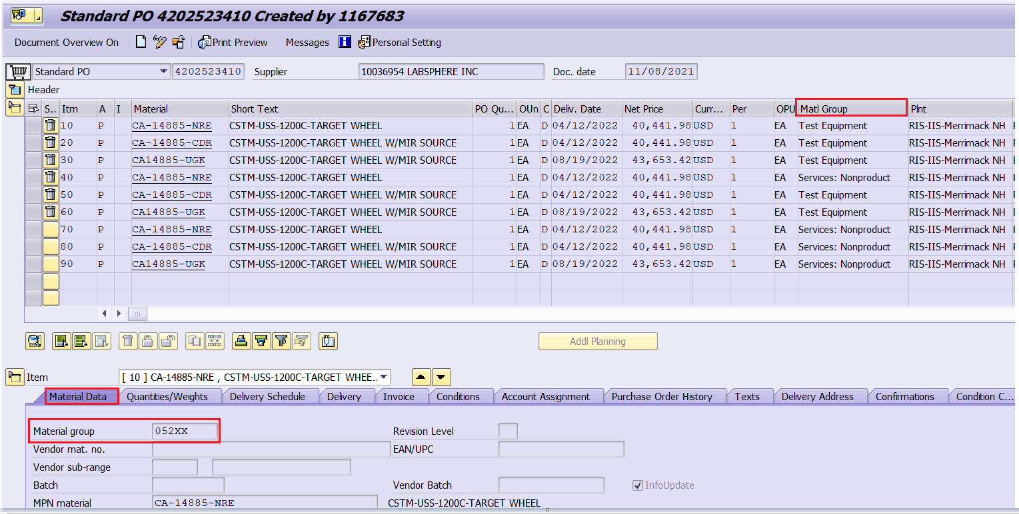
Key Driver - Material Group (SAP Transaction Code: ME23N)

Slide 5
Key Driver – Cost Center (Indirect Purchase)
“HOW” we are using the product is determined by cost center for indirect purchases
Cost center is tied to cost center category, which indicates how an item is being used:
  E - Development (R&D)
  F - Production (MFG)
  H - Service Cost Center
  L - Engineering Support (R&D)
  M - Material
  S - Production Support (MFG)
  V - Sales (POH)
  W - Administration (G&A)
  E, F, S, L are exempt across various states

Slide 6
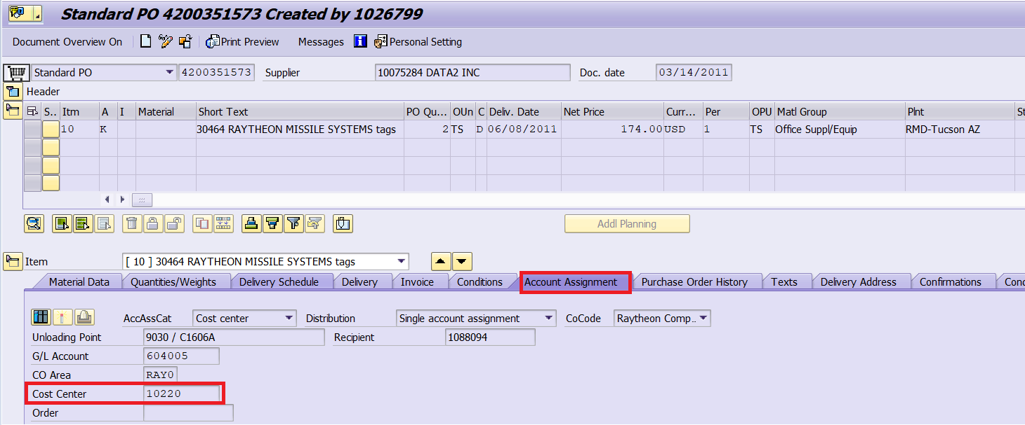
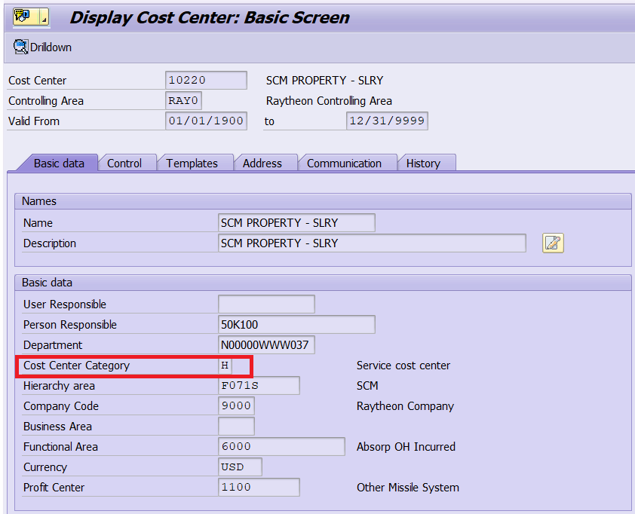
Key Driver - Cost Center in ME23N
Double click on cost center to drill down to Cost Center Category

Slide 7
Key Driver – Contract Tax Type (Direct Purchase)
“HOW” we are using the product for direct purchases is determined by Contract Tax Type
Contract Tax Type Concatenates:
  Distribution Channel
  Contract Type
  Usage Code
  Example:
    10|LSC|B = Government | Lump Sump | Hardware Contract
Material purchased on a cost plus (separated) service contract in Hawaii, Indiana, Louisiana, Mississippi and Virginia is taxable
In general, leases are taxable even if tied to a government contract
Distribution Channel
Channel | Description
10 | US Government
20 | Commercial (US Govt via OEM)
30 | Commercial
40 | International
50 | Internal (IOTs)
70 | Other
Contract Type
Code | Description
LSC | Lump Sum Contract
SC | Separated Contract
Usage Table
Code | Description
A | Service
B | Hardware – Long Term
C | Hardware – Non-Long Term

Slide 8
Material Purchased on Service Contract in VA
State | Contract Type | Services Taxable | Materials Taxable
VA | 10LSCA | N | Y
VA | 20LSCA | N | Y
VA | 30LSCA | N | Y
VA | 50LSCA | N | Y
VA | 10SCA* | N | Y
VA | 20SCA* | N | Y
VA | 30SCA* | N | Y
VA | 50SCA* | N | Y
*If there is a specific CLIN for material on a separated service contract, then no tax should apply. Please contact tax team at indirect.tax.tickets@rtx.com to have tax reversed.

Slide 9
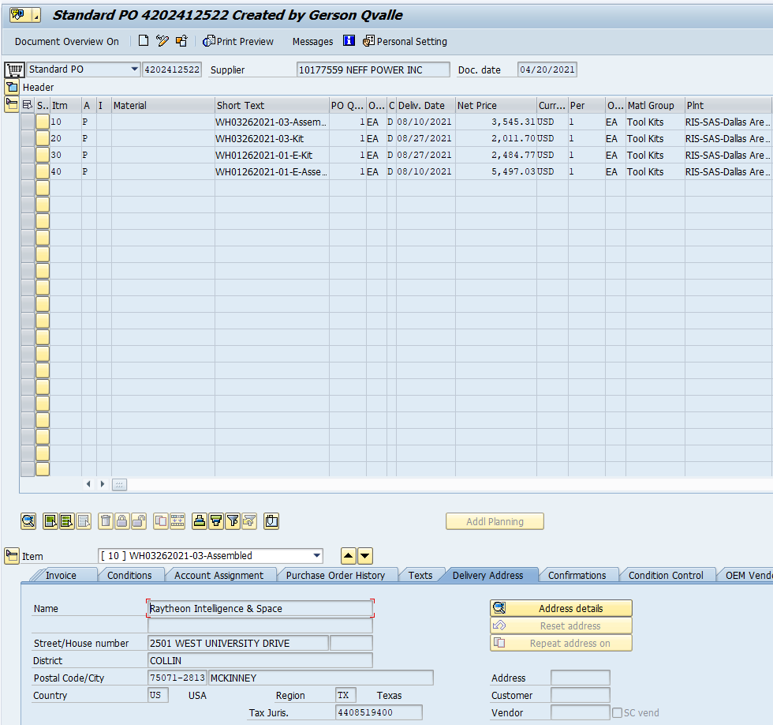
Key Driver – Delivery Address
  “WHERE” we are using the product is determined by the delivery address
  PO Delivery address should match the vendor invoice “ship to” address
  Resale, exemption, and direct pay certificates are also based on “ship to” delivery address.

Slide 10
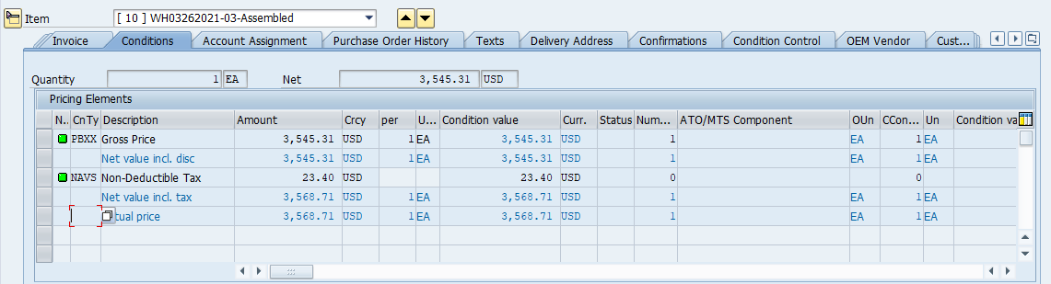
Conditions Tab
APEX and PRISM shows the tax that is expected to be charged by the vendor on the conditions tab of the PO line item
If Vertex determines the line item is exempt or a reduced rate applies, the tax amount in the conditions tab should be zero or a reduced amount of tax.
If there are no exceptions in Vertex, the purchased item is taxable and the tax amount will equal the tax rate multiplied by the net price of the goods purchased.

Slide 11
Indirect Tax Certificates
Direct Pay Permits
  Tax short paid to vendor and accrued by Raytheon
  Only applicable in certain states for which Raytheon has applied and obtained a permit
  Massachusetts contractors cannot accept MA direct pay permit. Include “LMT” in short text with material group 07809. Tax should be funded on the PO.
  Resale Certificates
  Issued when items will be resold
  Can be applicable in any state in which company is registered
Exemption Certificates
  Some states have exemptions for Research and Development or Manufacturing (E, F, S, L cost center categories)
Direct Pay States (9000/9721)
Alabama
Arizona
Arkansas
California
Florida
Indiana
Massachusetts
Mississippi
New York
Texas

Slide 12
Contact
Tax Certificate request:
  Email APCustomerService@CustHelp.com with PO number

