Slide 2
Supplier Rating System (SRS)
Supplier Protest Requests
Supplier Training Document
May 5, 2025

Slide 3
Agenda / Course Outline
What are SRS protest requests
Supplier submits a protest request
View the status of a protest
Email notifications
Frequently asked questions

Slide 4
Topic 1: What are SRS protest requests

Slide 5
What are SRS protest requests
On January 7, 2019, a new online process has been released which gives our Raytheon Suppliers the opportunity to formally protest performance elements affecting their Supplier Rating System (SRS) ratings. The feature enables our suppliers to submit protest requests for statistical delivery date, receipt date, or failure responsibility through SRS via the Raytheon Supplier Portal.
Benefits:
Raytheon Supply Chain Productivity
  Buyers will have time to do more productive supplier management activities
  Will enhance supplier excellence program by removing the need to adjudicate SRS scores to reflect accurate performance
  Will improve competitive source selection decisions by utilizing more accurate data
Improved Partnership
  Addresses consistent feedback from supplier perception surveys; Suppliers requested a formal process to contact RTN to update inaccurate SRS scores.
  This is a feature that, in the words of suppliers from the Raytheon Supplier Advisory Council, “Will be a competitive differentiator for Raytheon”.

Slide 6
SRS Protest Requests - Key Assumptions
SRS protest requests are for supplier performance relationship reports (SPRR)
  Protests can occur from PO Detail, Receipt Detail, or Failure Detail reports in SPRR (protests cannot occur from the SCAR Detail report or QDI’s)
The SRS protest requests from PO Detail and Receipt Detail will route to the buyer on record
The SRS protest requests from Failure Detail Reports will route to the Supplier Protest Council
Only one protest request per line item is allowed
  Once a supplier submits a protest request for a line item, regardless if it is accepted or rejected, the line item cannot be protested again

Slide 7
SRS Protest Request Status Definitions
Protest Request Status | Definition
Submitted | The supplier SRS protest request has been submitted to Raytheon for review.
In Review | The supplier SRS protest request is in review by Raytheon.
Accepted | The supplier SRS protest request has been accepted by Raytheon for processing. Raytheon will update the appropriate data source system. Changes should be reflected in SRS ratings in the next SRS update.
Rejected | The supplier SRS protest request has not been accepted by Raytheon. Although the SRS protest request to change SRS was reviewed thoroughly, the request will not be acted upon.

Slide 8
Topic 2: Supplier Submits a Protest Request

Slide 9
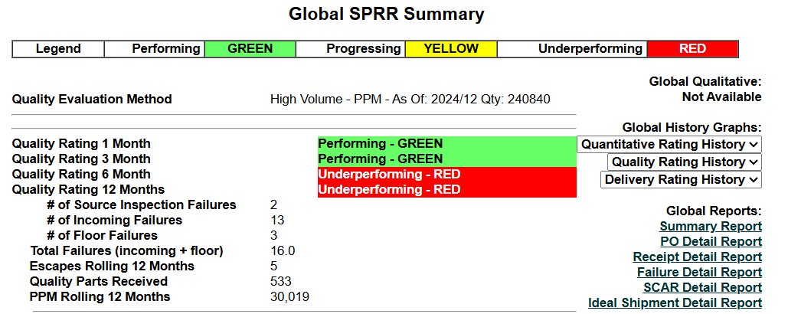
Supplier Selects Detail Report

Slide 10
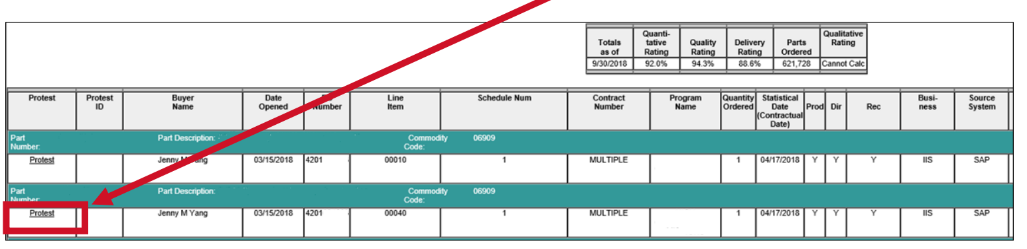
Supplier Clicks on Protest Line Item
Supplier reviews the SPRR report and clicks on the protest link of the line item they would like to protest

Slide 11
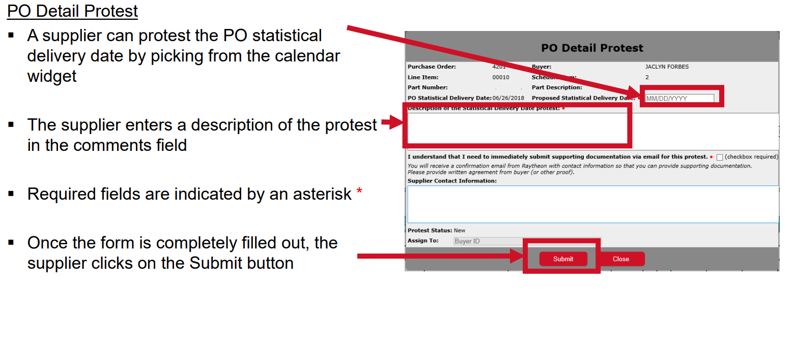
SRS Protest Pop-Up Window Opens

Slide 12
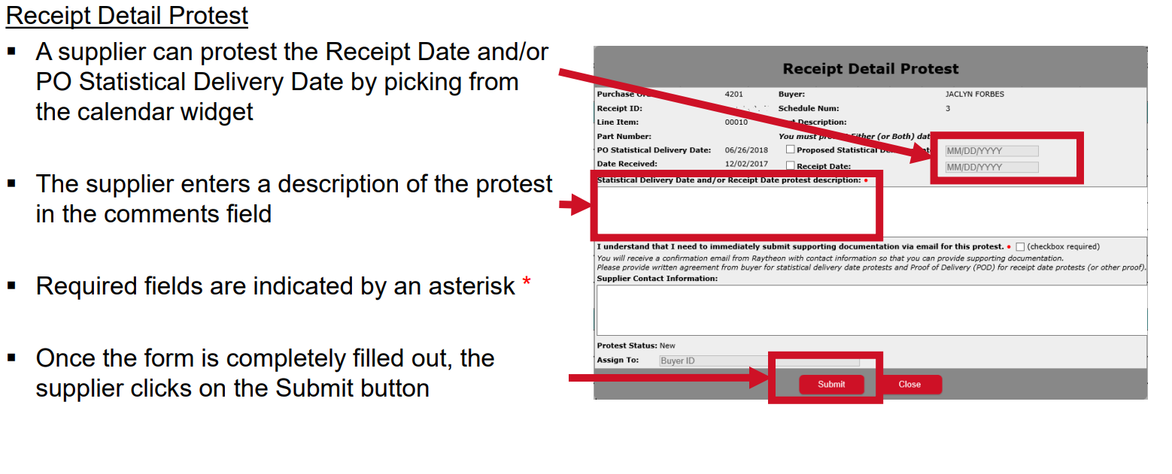
SRS Protest Pop-Up Window Opens

Slide 13
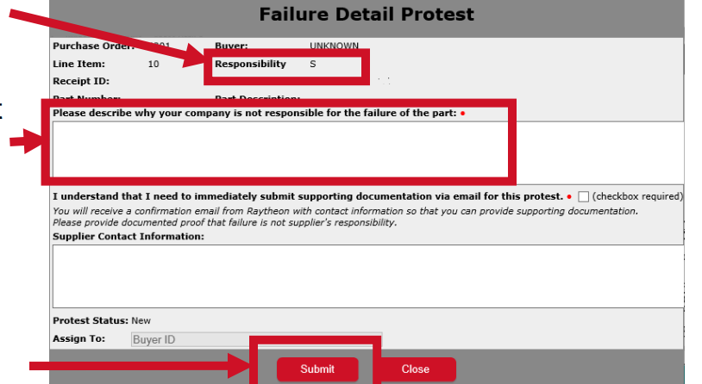
SRS Protest Pop-Up Window Opens
Failure Detail Protest
A supplier can protest the Failure Responsibility
The supplier enters a description of the protest in the comments field
Required fields are indicated by an asterisk *
Supplier Contact Information is used by RTX to request additional information
Once the form is filled out, the supplier clicks on the Submit button

Slide 14
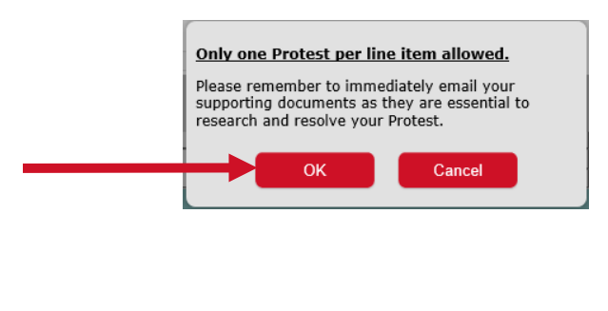
SRS Protest Confirmation Pop-Up Window
A pop-up window displays reminding the supplier to email supporting documents as these documents are required to research and resolve the protest
Supplier clicks on OK to proceed or Cancel to return to the previous pop-up window

Slide 15
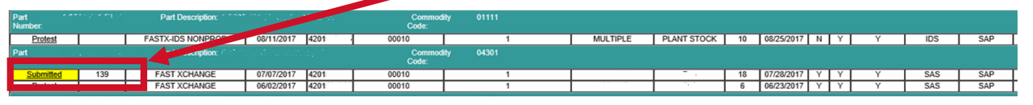
Supplier Receives Initial Submission Email
Upon successful submission of the protest request, the supplier will receive an email confirmation that the protest request has been submitted
The report will update the status from “Protest” to “Submitted” and the protest ID column will display a reference number
The supplier can check the protest request status on this screen (statuses are: Submitted, In Review, Accepted, Rejected)

Slide 16
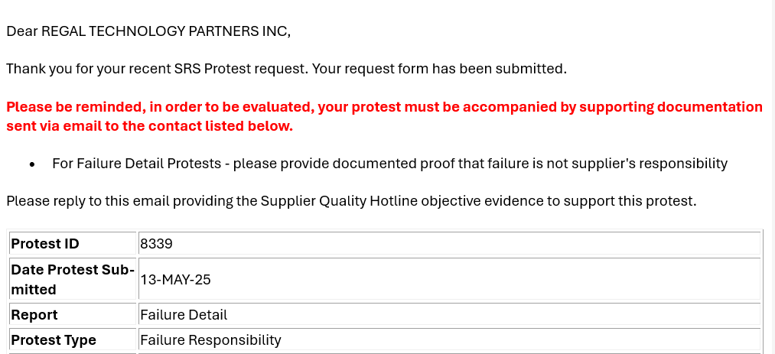
SRS Protest Pop-Up Window Opens
Dear Supplier Name
Please send supporting documentation to the Supplier Protest Council <Protest_Council@rtx.com>
1234

Slide 17
Objective Evidence and Supporting Documents
Quality Failure Protests
Suppliers should send all supporting documentation to the Protest Council within one week of submitting a protest. This can be done via an email to Protest_Council@rtx.com.
Statistical Date Protests
Suppliers should send supporting evidence to the buyer assigned to the PO

Slide 18
Topic 3: View the Status of a Protest

Slide 19
Supplier Receives Initial Submission Email
The supplier can view the status of an SRS protest request:
  Utilize the submission confirmation email to determine the Protest ID number
  Access the PO, Receipt, or Failure Detail reports
The supplier can check the protest request status on this screen (statuses are: Submitted, In Review, Accepted, Rejected)

Slide 20
Topic 4: Email Notifications

Slide 21
Automatic Email Notifications
Quality Failure Protests
If additional information is requested by the council, the supplier contact listed in the protest will receive an email with a request to provide additional evidence to the Protest Council.
Statistical Date Protests
After a supplier completes the SRS protest request, both the supplier and buyer receive confirmation that the request has been submitted for review
If the SRS protest request is re-assigned to another buyer, then the supplier, the original assigned buyer, and the newly assigned buyer will receive notification

Slide 22
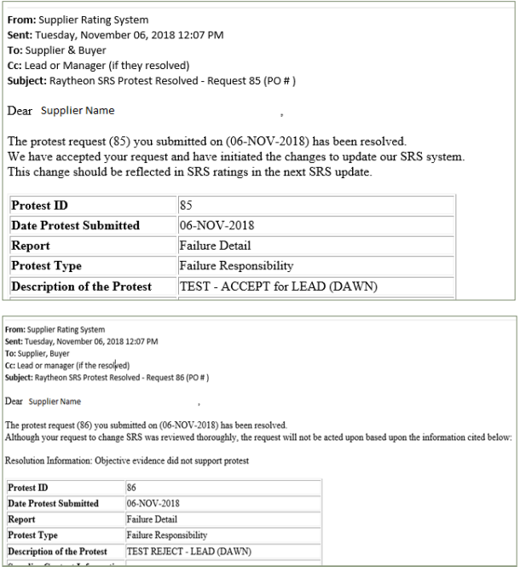
Status Change of a Protest to either Accepted or Rejected
A status change of an SRS protest request to either accepted or rejected will trigger a resolution email to the supplier
Emails for rejected protest requests will include a reason for the rejection
Supplier will be notified via email once the protest request is resolved

Slide 23
Topic 5: Frequently Asked Questions

Slide 24
Frequently Asked Questions
Q: I submitted a Quality Failure Protest request. When can I expect to receive resolution of the protest request from RTX?
A: Quality Failure Protest are typically closed at three weeks from creation date and will be closed within four weeks from creation.
Q: I submitted a Statistical Date Protest request. When can I expect to receive resolution of the protest request from Raytheon?
A: Once the buyer receives the supporting documentation, the information will be reviewed. Open protest requests will follow internal escalation procedures for timely responses. Please note that the resolution may not be immediately reflected in SRS data due to timing of SRS updates.
.

Slide 25
Frequently Asked Questions
Q: Will my protest request become public knowledge?
A: No, the protest request records are maintained in a database to which only Raytheon and the respective Supplier have access.
Q: How do I check the status of a protest request?
A: Suppliers can check the status of a protest request by viewing the PO, Receipt, or Failure detail reports where suppliers initiated the protest request (reports accessed via the SPRR). See topic 3. Once a resolution is determined, an email will be sent to both the supplier and the buyer.
Q: Why am I unable to protest a line item more than once?
A: Once a protest request has been resolved, the Council has completed any necessary investigation and has determined the final resolution. Once final resolution has been determined, the item cannot be protested again.

Slide 26
Frequently Asked Questions
Q: I’m unsure if I should protest a QN, what should I do?
A: Contact your assigned RTX FSQE representative to support questions related to QNs.
Q: What is objective evidence?
A: This may include testing results, inspection reports, photos, or other clear reasoning that explains why the protest should be accepted. Any technical data must be sent securely.
Q: My protest request was accepted, but SRS is not reflecting the update. What do I do?
A: If SRS has not been updated after the protest request was accepted, please contact the buyer. If further assistance is needed, contact the Raytheon helpdesk 877-844-4712.

